Slide 1

Queses:
  Array and list representation,
  Operations (traversal, insertion and deletion)
Priority queues and Deques:
  Array and List representations

Slide 2
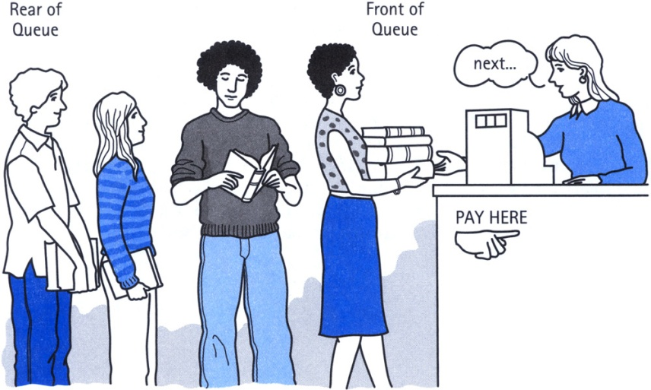
Definition of Queue
A Queue is an ordered collection of items from which items may be deleted at one end (called the front of the queue) and into which items may be inserted at the other end (the rear of the queue).
The first element inserted into the queue is the first element to be removed. For this reason a queue is sometimes called a FIFO (first-in first-out) list as opposed to the stack, which is a LIFO (last-in first-out).

Slide 3
It is a linear data structure in which new elements are inserted at one end and elements are deleted from the other end.
This mechanism is called First-In-First-Out (FIFO).
Placing an item in a queue is called “insertion or enqueue”, which is done at the end of the queue called “rear”(or tail).
Removing an item from a queue is called “deletion or dequeue”, which is done at the other end of the queue called “front”(head).

Slide 4
ENQUEUE:The enqueue operations is used to insert a new element to the rear of the queue .After the enqueue operation, the element that has just been inserted becomes the rear, Each enqueue operations increases the number of elements in the queue by one.
DEQUEUE:This is used to remove the existing element from the front of the queue.After removing the element from the front,the next older element becomes the front of the queue.Each dequeue operation reduces the number of element in the queue by one.

Slide 5
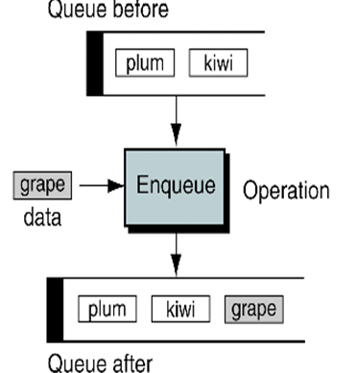
Enque

Slide 6
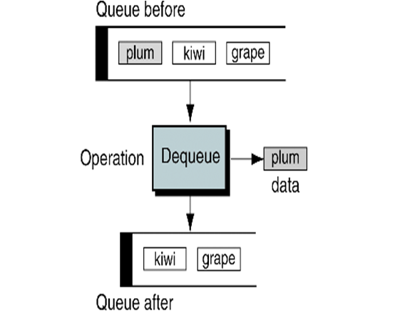
Dequeue

Slide 7
Queue
items[MAXQUEUE-1]
. | .
. | .
. | .
items[2] | C
items[1] | B
items[0] | A
Rear=2
Front=0

Slide 8
Insert an item A
A new item (A) is inserted at the Rear of the queue
items[MAXQUEUE-1]
. | .
. | .
items[3]
items[2]
items[1]
items[0] | A | Front=0, Rear=0

Slide 9
Insert an item B
A new item (B) is inserted at the Rear of the queue
items[MAXQUEUE-1]
. | .
. | .
items[3]
items[2]
items[1] | B | Rear=1
items[0] | A | Front=0

Slide 10
Insert an item C
A new item (C) is inserted at the Rear of the queue
items[MAXQUEUE-1]
. | .
. | .
items[3]
items[2] | C | Rear=2
items[1] | B
items[0] | A | Front=0

Slide 11
Insert an item D
A new item (D) is inserted at the Rear of the queue
items[MAXQUEUE-1]
. | .
. | .
items[3] | D | Rear=3
items[2] | C
items[1] | B
items[0] | A | Front=0

Slide 12
Insert Operation(Array)
QINSERT(QUEUE, N, FRONT, REAR, ITEM)
If FRONT = 1 and REAR = N, or FRONT = REAR + 1, then :
write OVERFLOW, and Return.
2. If FRONT = NULL, then:
Set FRONT := 1 and REAR := 1.
Else if REAR = N, then:
Set REAR := 1.
Else :
Set REAR := REAR + 1.
3. Set QUEUE[REAR]:= ITEM.
4. Exit.

Slide 13
Delete A
An item (A) is deleted from the Front of the queue
items[MAXQUEUE-1]
. | .
. | .
items[3] | D | Rear=3
items[2] | C
items[1] | B | Front=1
items[0] | A

Slide 14

Delete B
An item (B) is deleted from the Front of the queue.
items[MAXQUEUE-1]
. | .
. | .
items[3] | D | Rear=3
items[2] | C | Front=2
items[1] | B
items[0] | A

Slide 15
Delete C
An item (C) is deleted from the Front of the queue
items[MAXQUEUE-1]
. | .
. | .
items[3] | D | Front=Rear=3
items[2] | C
items[1] | B
items[0] | A

Slide 16
Delete D
An item (A) is deleted from the Front of the queue.
items[MAXQUEUE-1]
. | .
items[3] | D | Front=Rear=-1
items[2] | C
items[1] | B
items[0] | A

Slide 17
Delete Operation(Array)
QDELETE(QUEUE, N, FRONT, REAR, ITEM)
If FRONT = NULL then :
write: UNDERFLOW, and Return.
2. Set ITEM := QUEUE[FRONT].
3. If FRONT = REAR,
Set FRONT := NULL and REAR := NULL
Else if FRONT = N, then:
Set FRONT := 1.
Else :
Set FRONT := FRONT + 1.
4. Return.

Slide 18
Insert Operation(LL)
LINKQ_INSERT(INFO, LINK, FRONT, REAR, AVAIL, ITEM)
If AVAIL = NULL, then :
write OVERFLOW, and Exit.
2. Set NEW := AVAIL and AVAIL := LINK[AVAIL]
3. Set INFO[NEW]:= ITEM and LINK[NEW]=NULL
4. If FRONT = NULL , FRONT := REAR := NEW
Else :
set LINK[REAR] := NEW and REAR := NEW
5. Exit

Slide 19
Delete Operation(LL)
LINKQ_DELETE(INFO, LINK, FRONT, REAR, AVAIL, ITEM)
If FRONT = NULL, then :
write UNDERFLOW, and Exit.
2. Set TEMP := FRONT
3. Set ITEM :=INFO[FRONT]
4. FRONT :=LINK[FRONT]
5. LINK[TEMP] = AVAIL and AVAIL = TEMP
6. Exit

Slide 20
Priority Queue
More specialized data structure.
Similar to Queue, having front and rear.
Items are removed from the front.
Items are ordered by key value so that the item with the lowest key (or highest) is always at the front.
Items are inserted in proper position to maintain the order.

Slide 21
DEQueue
It is a double-ended queue.
Items can be inserted and deleted from either ends.
More versatile data structure than stack or queue.
E.g. policy-based application (e.g. low priority go to the end, high go to the front)

Slide 22
DEQUE
A deque(double ended queue) is one of variation of a queue.
A deque is a linear link that allows insertion and deletion at either end,i.e. at the front or rear of the queue but not in the middle.
Generally the leftmost element represents the front and the rightmost elements represent the rear.

Slide 23
The four basic operations that can be performed on deque are insertLeft,insertRight,deleteLeft and deleteRight.
The insertLeft and deleteLeft inserts and deletes an element to/from the left of the deque repectively
The insertRight and deleteRight inserts and deletes an element to/from the right of the deque respectively.
There are multiple ways of implementing a deque,but most commomly used implementations are circular array and doubly linked list.

Slide 24
Deque can be classified as
input restricted deque.
output restricted deque.
In input restricted deque,the insertion of an element is restricted to one end only but deletion can take place at both the ends.
The operations that are possible on input restricted deque are insertRight,deleteRight and deleteLeft.

Slide 25
An output restricted deque is a deque which allows deletion at only one end of the list but allow insertion at both ends of the list.
The operations that are possible on output restricted deque are deleteLeft,insertRight and insertLeft.

Slide 26
Thank You

